Slide 1
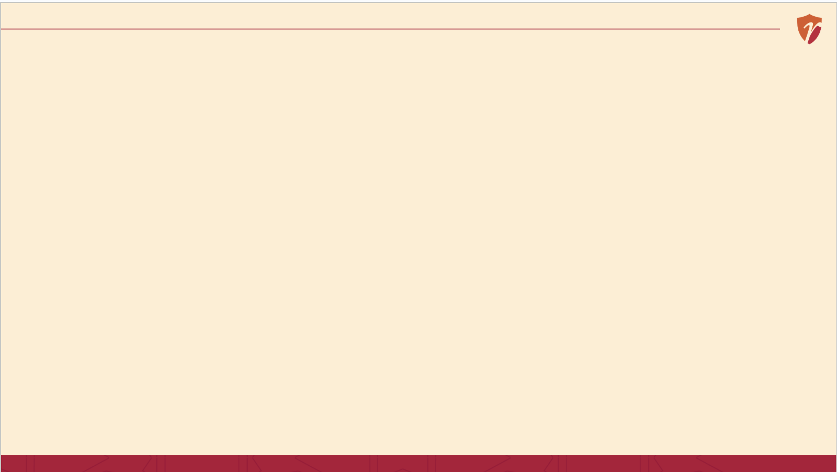
Week 1 Session 3 and 4
Based on: A. Nag, Strategic Management: Analysis, Implementation and Control, Ch. 4.
6 / 15

Slide 2
RECAP
Last Session

Slide 3
RECAP
Last Session
A policy is a standing guideline — a boundary, not a script
A program is a time-bound set of activities aimed at one goal
A procedure is a fixed, repeatable, step-by-step method

Slide 4
BUILDING BLOCK 1 OF 4
Budget?
Based on: A. Nag, Strategic Management: Analysis, Implementation and Control, Ch. 4.
6 / 15

Slide 5
BUILDING BLOCK 1 OF 4
What Is a Budget?
A plan expressed in numbers how much money will be spent, on what, and by when.
A budget turns good intentions into a resource commitment it forces you to choose, because money is always limited.
Example
“₹8,000 for ingredients, ₹3,000 for gas and packaging, ₹2,000 for a helper this month, no more.”
Based on: A. Nag, Strategic Management: Analysis, Implementation and Control, Ch. 4.
6 / 15

Slide 6
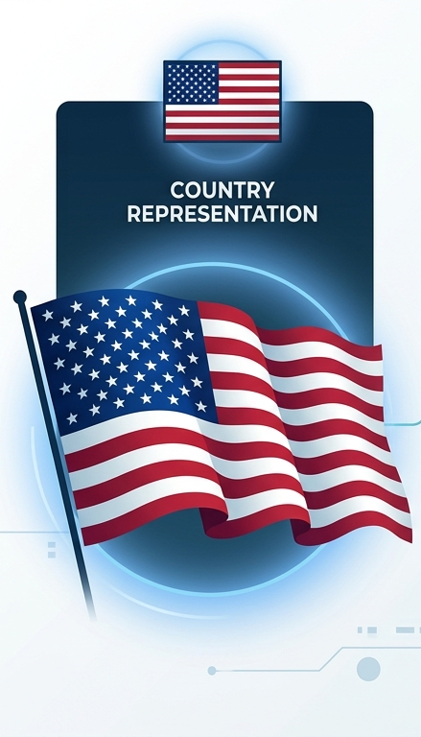
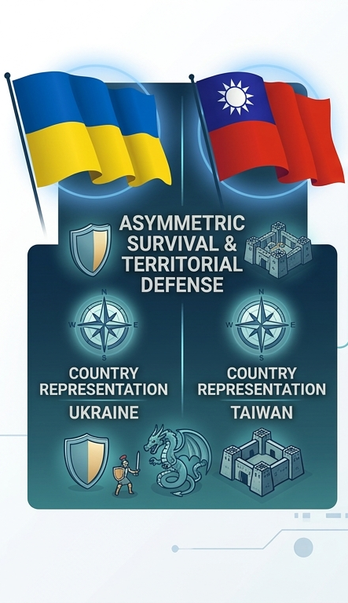
Observation
Identity of any country

Slide 7
BUILDING BLOCK 4 OF 4
What Is a Tactic?
Based on: A. Nag, Strategic Management: Analysis, Implementation and Control, Ch. 4.
9 / 15

Slide 8
BUILDING BLOCK 4 OF 4
What Is a Tactic?
A short-term, specific move made to gain an immediate advantage.
If a program is a whole campaign, a tactic is one small, quick action inside it often decided in the moment, not planned months ahead.
Example
“Free chutney sachet for the first 20 customers this Friday” a quick, small nudge, not a big plan.
Based on: A. Nag, Strategic Management: Analysis, Implementation and Control, Ch. 4.
9 / 15

Slide 9
BACK TO BONSHO'S MOMOS
His Budget & Tactics
Budget
₹6,000/month on vegetables, ₹2,500 on gas and packaging, ₹1,500 set aside for a helper on weekends ₹10,000 total, tracked weekly.
Tactic
Noticing a slow Tuesday afternoon, Mohit/Aditya hands out a free chutney sachet to the next 20 customers a quick, unplanned nudge.
“Priya's Momos” is a fictional business created for classroom illustration only.
11 / 15

Slide 10
CORE CONCEPT 1
Mission
Based on: A. Nag, Strategic Management: Analysis, Implementation and Control, Ch. 4.
6 / 15

Slide 11
CORE CONCEPT 1
What Is a Mission?
A mission is the reason a business exists broader than any single goal, and stable even as objectives, budgets and tactics change year to year.
Amul's mission, in spirit
“To give India's dairy farmers fair, remunerative returns for their milk.” That idea hasn't changed since 1946 even as the specific objectives, budgets and products around it changed constantly.
Based on: A. Nag, Strategic Management: Analysis, Implementation and Control, Ch. 4.
6 / 15

Slide 12
BACK TO BONSHO'S MOMOS
He Writes His Mission Statement
“To bring fresh, hygienic, affordable momos to every student in this city, without them ever having to choose between taste and their budget.”
Notice: this mission doesn't mention 100 plates a day, or gloves, or Friday combos. It's bigger and slower-moving than any of those everything else we've written for Bono serves this one idea.
“Priya's Momos” is a fictional business created for classroom illustration only.
9 / 15

Slide 13
A STORY TO START
Why a Farmers' Cooperative Needed a Mission
1946, Anand, Gujarat
A group of local dairy farmers, tired of unfair middlemen, form a cooperative. No fancy office, no big budget just farmers and milk.
The mission that held it together
Give farmers themselves fair, remunerative returns for their milk — not maximize profit for a few owners. Every later decision traced back to that one idea.
Today
That cooperative is one of India's largest food brands, still owned by its farmer-members. A clear mission, followed for decades, built an empire no single budget or tactic ever could alone.
History based on widely documented accounts of Amul's founding (1946) as a farmers' cooperative.
5 / 15

Slide 14
A USEFUL DISTINCTION
Mission, Goal & Objectives: What's the Difference?
Based on: A. Nag, Strategic Management: Analysis, Implementation and Control, Ch. 4.
7 / 15

Slide 15
A USEFUL DISTINCTION
Mission, Goal & Objectives: What's the Difference?
Mission | Goal | Objectives
Why the business exists | What the business aims/wants to achieve overall (long-term) | What it's trying to achieve, right now
Broad, stable, rarely changes | Medium to long-term, semi-broad, updated periodically | Specific, measurable, changes often
“Fair returns for farmers” | Expand the milk procurement and processing network | “Increase milk procurement 10% this year”
Based on: A. Nag, Strategic Management: Analysis, Implementation and Control, Ch. 4.
7 / 15

Slide 16
CORE CONCEPT 2
The Full Stack: From Mission to Tactic
Mission
Why we exist
Goal
What we want to achieve over the long term
Objectives
What we're specifically trying to achieve
Strategy
Policy
The standing guidelines we follow
Program
The time-bound activities we run
Procedure
The exact steps we repeat
Budget
The numbers behind it all
Tactic
The quick moves we make in the moment

Slide 17
BACK TO BONSHO'S MOMOS
His Complete Picture, All Nine Blocks
Mission
Fresh, hygienic, affordable momos for every student
Goal
Become the most popular student momo spot in the area / Become the go-to campus momo stall
Objective
100 plates/day within 3 months
Strategy
Policy
Only fresh vegetables, never leftovers
Program
Friday Combo Week
Procedure
5-step plating process, every order
Budget
₹10,000/month, tracked weekly
Tactic
Free chutney for first 20 on slow days
10 / 15

Slide 18
A COMMON MISTAKE
Why Some Founders Get This Wrong
11 / 15

Slide 19
A COMMON MISTAKE
Why Some Founders Get This Wrong
1
Writing an inspiring mission, then never translating it into a real objective or budget
2
Setting strict procedures and policies with no mission behind them staff follow rules without understanding why
3
Running exciting tactics and programs that quietly contradict the stated mission
4
The fix: everything below the mission should trace back up to it, cleanly
11 / 15

Slide 20
SUMMARY
Key Takeaways from Today
A budget is a plan expressed in numbers — it forces real trade-offs
A tactic is a quick, short-term move — smaller and faster than a program
A mission is the reason a business exists — broad and stable, unlike an objective
All Nine building blocks — mission, objectives, policy, program, procedure, budget, rule, tactic — should trace back to one mission
14 / 15

Slide 21
REFERENCES & NEXT SESSION
Sources & What's Coming Up
Required Reading
Coming Up — Week 2
A. Nag — Strategic Management: Analysis, Implementation and Control, Ch. 4
Further Resources
Kazmi, A. — Business Policy and Strategic Management
Fred R. David — Strategic Management Concepts
15 / 15

